Slide 1
Matches App
Case Study Project
By Atul Ware

Slide 2
Index
Hardware Requirement
Software Requirement
Synopsis
Service Requirements
Features
Use Case Diagram

Slide 3
Hardware Requirement
Processor - 2 GHz and above
Hard Disk - 500 GB
RAM - 4 GB

Slide 4
Software Requirement (Back end)
Software (IDE / Frameworks)-
Spring (STS)
MongoDB
Git bash
Postman
Chrome Browser
JDK 11
Mockito
Junit

Slide 5
Software Requirement (Front end)
Software (IDE / Frameworks)-
Visual Studio Code
Chrome Browser

Slide 6
Synopsis
The Matches App application gives the more information about matches. It gives better and smooth schedule of all the matches. Using this can add and fetch the match details. User can easily access the match details by upcoming match schedule and old matches done, also recommendations. In this application it lists the match details.
The user wants to register first and login to access the system. Once registered user can login through username and password provided by him. After logging in the user should select the kind of activity he would like to perform. User can search match details by giving specific details.

Slide 7
Service Requirement
Login
Eureka
API Gateway
Adding Matches (Admin)
User Services

Slide 8
Features
Registration and Login Authentication.
Smooth schedule of matches
Gives the information of matches for users

Slide 9
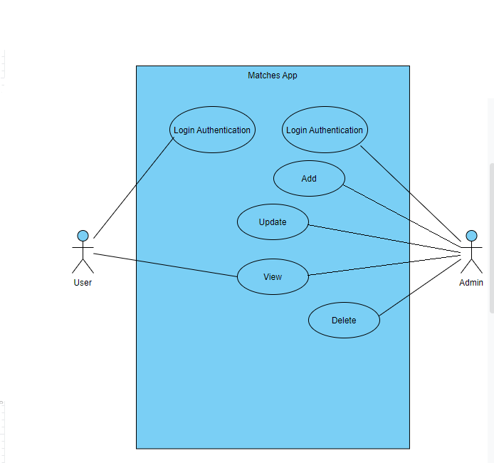
Use Case Diagram

